Slide 1

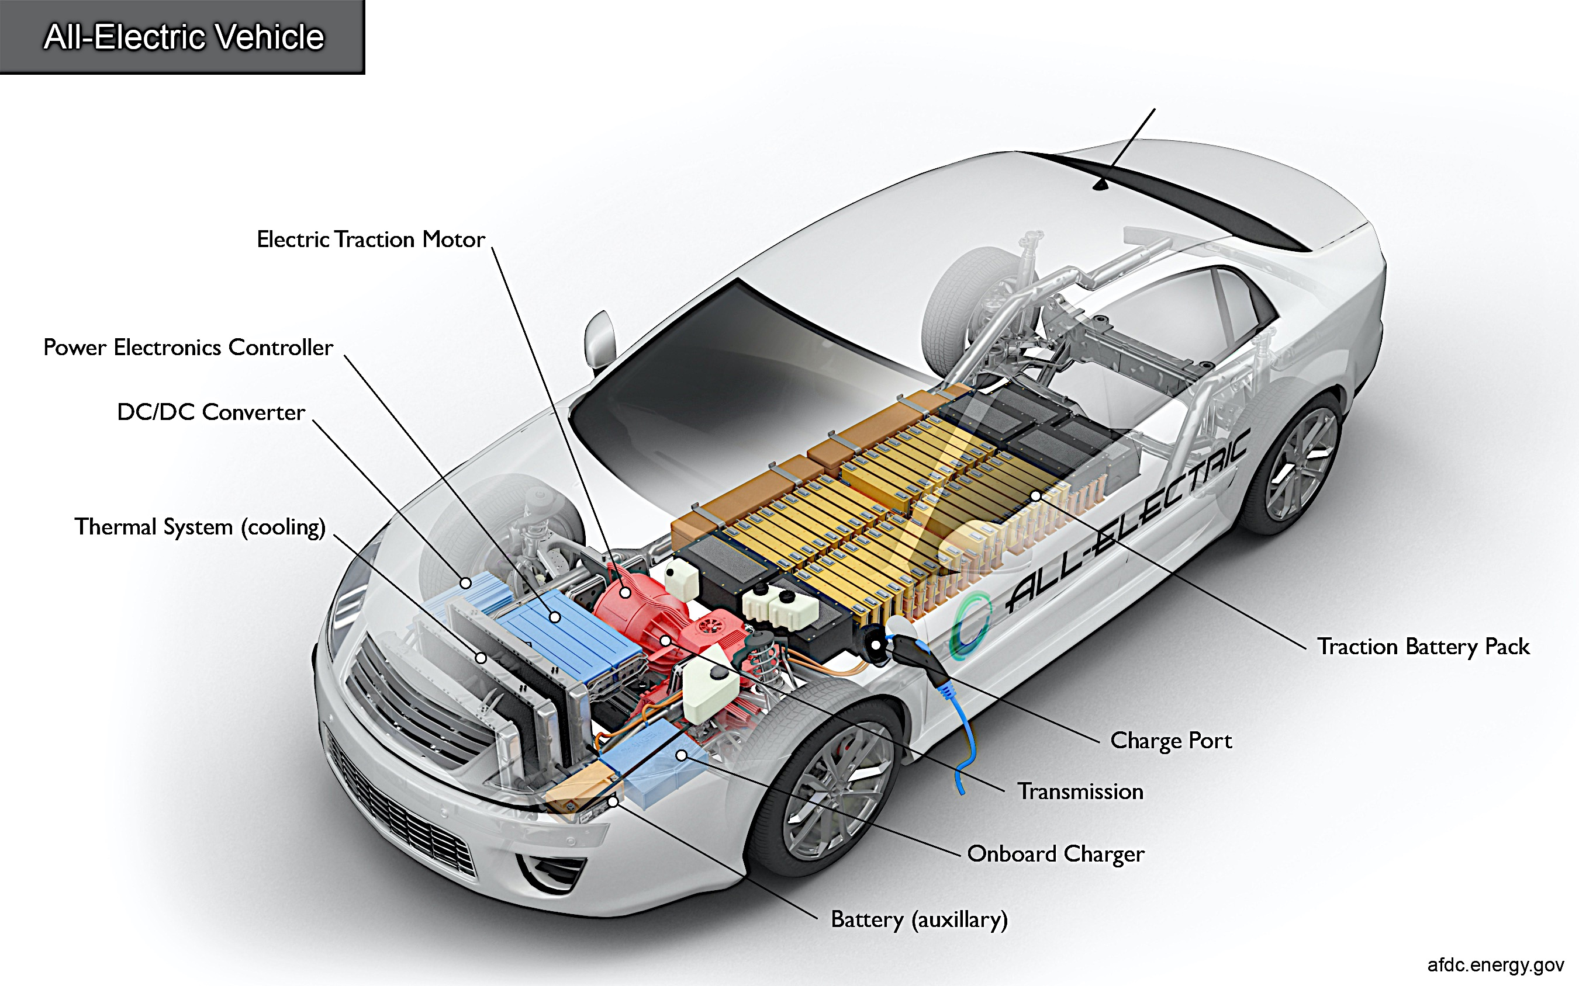
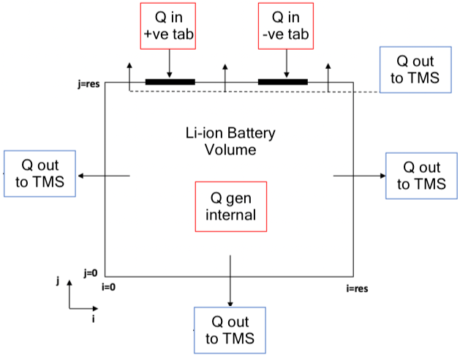
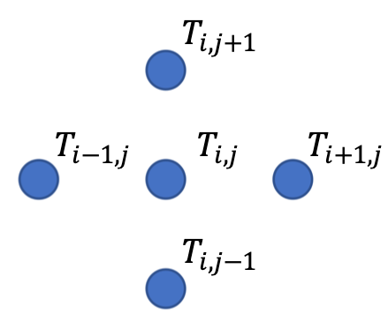


Numerical Modelling of Thermal Management Systems for Lithium-ion Batteries
Omar Elsewify
Supervisor: Masoud Jabbari
BEng Mechanical Engineering
Poster: TF17
1.0 Introduction
5.0 Results
With the rapid depletion of fossil fuels, the automotive industry has had to find an alternative renewable power source.
Electrically driven vehicles (EDVs), powered by Li-Ion cells appear to be the most suitable replacement for petrol cars.
However, there are several obstacles associated with the use of these Li-Ion batteries such as:
Mileage, cycle life, charging time, safety and reliability.
For these results the conditions applied are:
Coolant Temperature = 25ºC
Heat out from sides (q) = 100 W/m²
Internal heat generated = 1 kW/m²
Increasing the heat convection coefficient (h) to replicate different flow velocities around the cell, while k = 11.2W/mK. It appears that increasing h results in ideal temperature patterns.
(a) (b) (c)
2.0 Aims and Objectives
To reduce the maximum (peak) temperature within the cell
To reduce the temperature gradients within the cell to safe levels
To find the optimal thermal management system setup which would improve performance
Figure 4: Effect of convective heat transfer (a) h=30W/m²K (b) h=50W/m²K (c) h=70W/m²K
Figure 1: Diagram of the main components involved in the thermal management of electric vehicle cells
Increasing the internal conduction coefficient (k) to replicate different internal cell models, while h = 30W/m²K. The greater the conductivity, the lower the T_{max} and the more even the temperature distribution.
3.0 Model Theory and Concept
4.0 Methodology
The governing equation for this 2D model is the heat conduction equation given by:
(Eqn.1)
Where: $ρ$ is density kg/m³, $c_{p}$ is specific heat capacity J/kgK, $k$ is material conductivity (W/mK) and ${\dot{Q}}^{′′}$ is internal heat generation (W/m³).
(a) (b) (c)
At the current stage of the project the numerical model is simplified into a steady state problem therefore the assumption is made that dT/dt = 0
In order to solve this equation a finite difference equation is used to approximate the second order derivatives involved.
Figure 5: Effect of conductive heat transfer (a) k=5W/mK (b) k=10W/mK (c) k=15W/mK
6.0 Future Work
(a) (b)
Create time dependent internal heat generation and probe the cell at specific time intervals in a load cycle
Investigate use of phase change material, liquid cooling and air cooling as BTM systems.
Vary the flow rates of the cooling systems to monitor the effect on temperature distribution
Compare results from MATLAB to thermal camera results [3].
Figure 3: (a) XALT-Energy Li-Ion battery pouch (b) Illustration of the cell boundary conditions
Model
Battery geometry according to industry use
Boundary conditions as prescribed in Figure 3
Steady state equations in discretized form
Test
Under time dependent current and voltage
Using various charging speeds
Using various flow speeds for air cooling
Using fluids with varying thermal properties
References
Figure 2: 5-point stencil used to discretize the heat conduction equation
[1] Deng, et. al (2018). 'Effects of different coolants and cooling strategies on the cooling performance of the power lithium ion battery system: A review', Applied Thermal Engineering, 142, pp. 10-29.
[2] Jabbari, M. (2019). CAE/CFD LECTURE 6 – MATLAB LIVE. University of Manchester
[3] Hosseinzadeh, et al. (2018). 'A systematic approach for electrochemical-thermal modelling of a large format lithium-ion battery for electric vehicle application', Journal of power sources, 382, pp. 77-94.
$\frac{∂^{2}T_{i,j}}{∂x^{2}}≈\frac{1}{h^{2}}(T_{i+1,j}−2T_{i,j}+T_{i−1,j})$ (Eqn.2)
$\frac{∂^{2}T_{i,j}}{∂y^{2}}≈\frac{1}{h^{2}}(T_{i,j+1}−2T_{i,j}+T_{i,j−1})$ (Eqn.3)
$∇^{2}T_{i,j}=\frac{∂^{2}T_{i,j}}{∂x^{2}}+\frac{∂^{2}T_{i,j}}{∂y^{2}}=\frac{1}{h^{2}}(T_{i+1,j}+T_{i−1,j }{+ T}_{i,j+1}+T_{i,j−1}−4T_{i,j})$ (Eqn.4)
Evaluate
Establish a baseline when no TMS deployed
Compare patterns at specific time intervals
Find an optimal system to reduce temperature gradients and peak temperature

